Slide 1
RESUME BUILDER
112003001 Mrunali Adhal
112003012 Prajakta Baad

Slide 2
Why this Project?
We require a resume for any form of interview or job application. Making a good resume is a difficult task.
So, by utilizing this application, we can easily create a resume by simply entering our information.
Single user can create multiple Resume for various portfolios

Slide 3
Features:
Multiple users can register.
No repetition of user is allowed.
User an create their resume by just entering data.
User can edit it easily.
User can get PDF of the resume.
Facility for getting forgotten password.

Slide 4
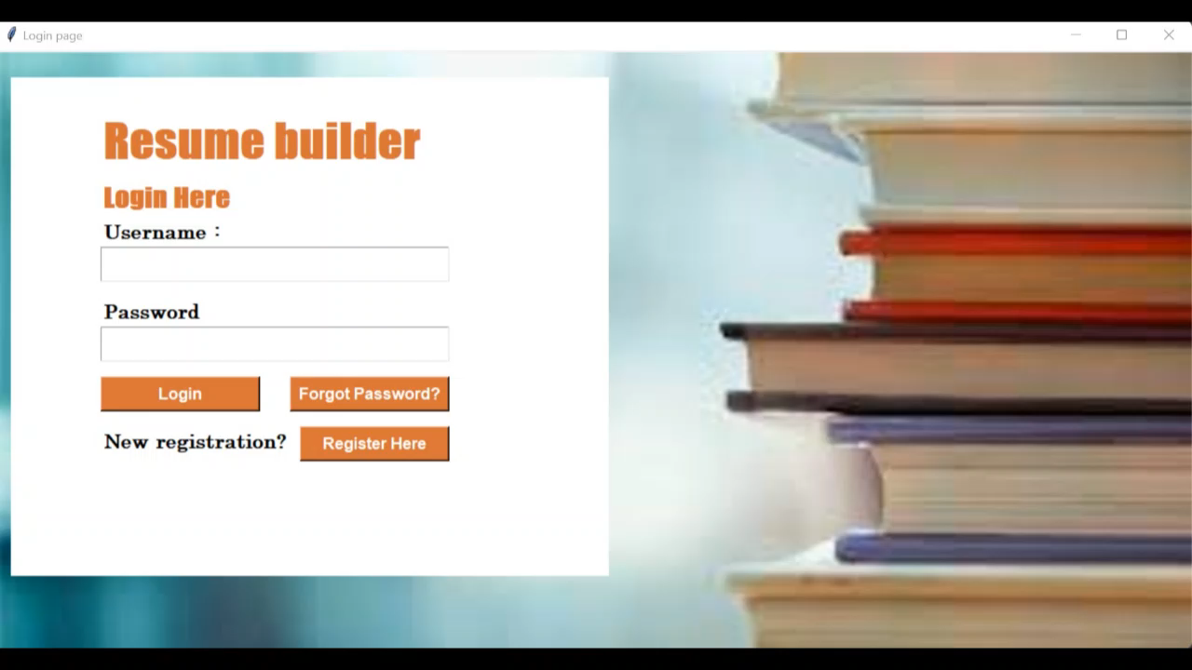
Project Walkthrough

Slide 5
